Slide 1
THE LIFE OF CHRIST
PART 49

Slide 2
Mark 9:33 Then He came to Capernaum. And when He was in the house He asked them, "What was it you disputed among yourselves on the road?" ³⁴ But they kept silent, for on the road they had disputed among themselves who would be the greatest. ³⁵ And He sat down, called the twelve, and said to them, "If anyone desires to be first, he shall be last of all and servant of all."

Slide 3
"If anyone desires to be first, he shall be last of all and servant of all."

Slide 4
Matthew 18:1 At that time the disciples came to Jesus, saying, "Who then is greatest in the kingdom of heaven?"

Slide 5
Luke 9:47 And Jesus, perceiving the thought of their heart, took a little child and set him by Him,

Slide 6
Matthew 15:18 "But those things which proceed out of the mouth come from the heart, and they defile a man. ¹⁹ "For out of the heart proceed evil thoughts, murders, adulteries, fornications, thefts, false witness, blasphemies.

Slide 7
Mark 9:36 Then He took a little child and set him in the midst of them. And when He had taken him in His arms, He said to them,

Slide 8
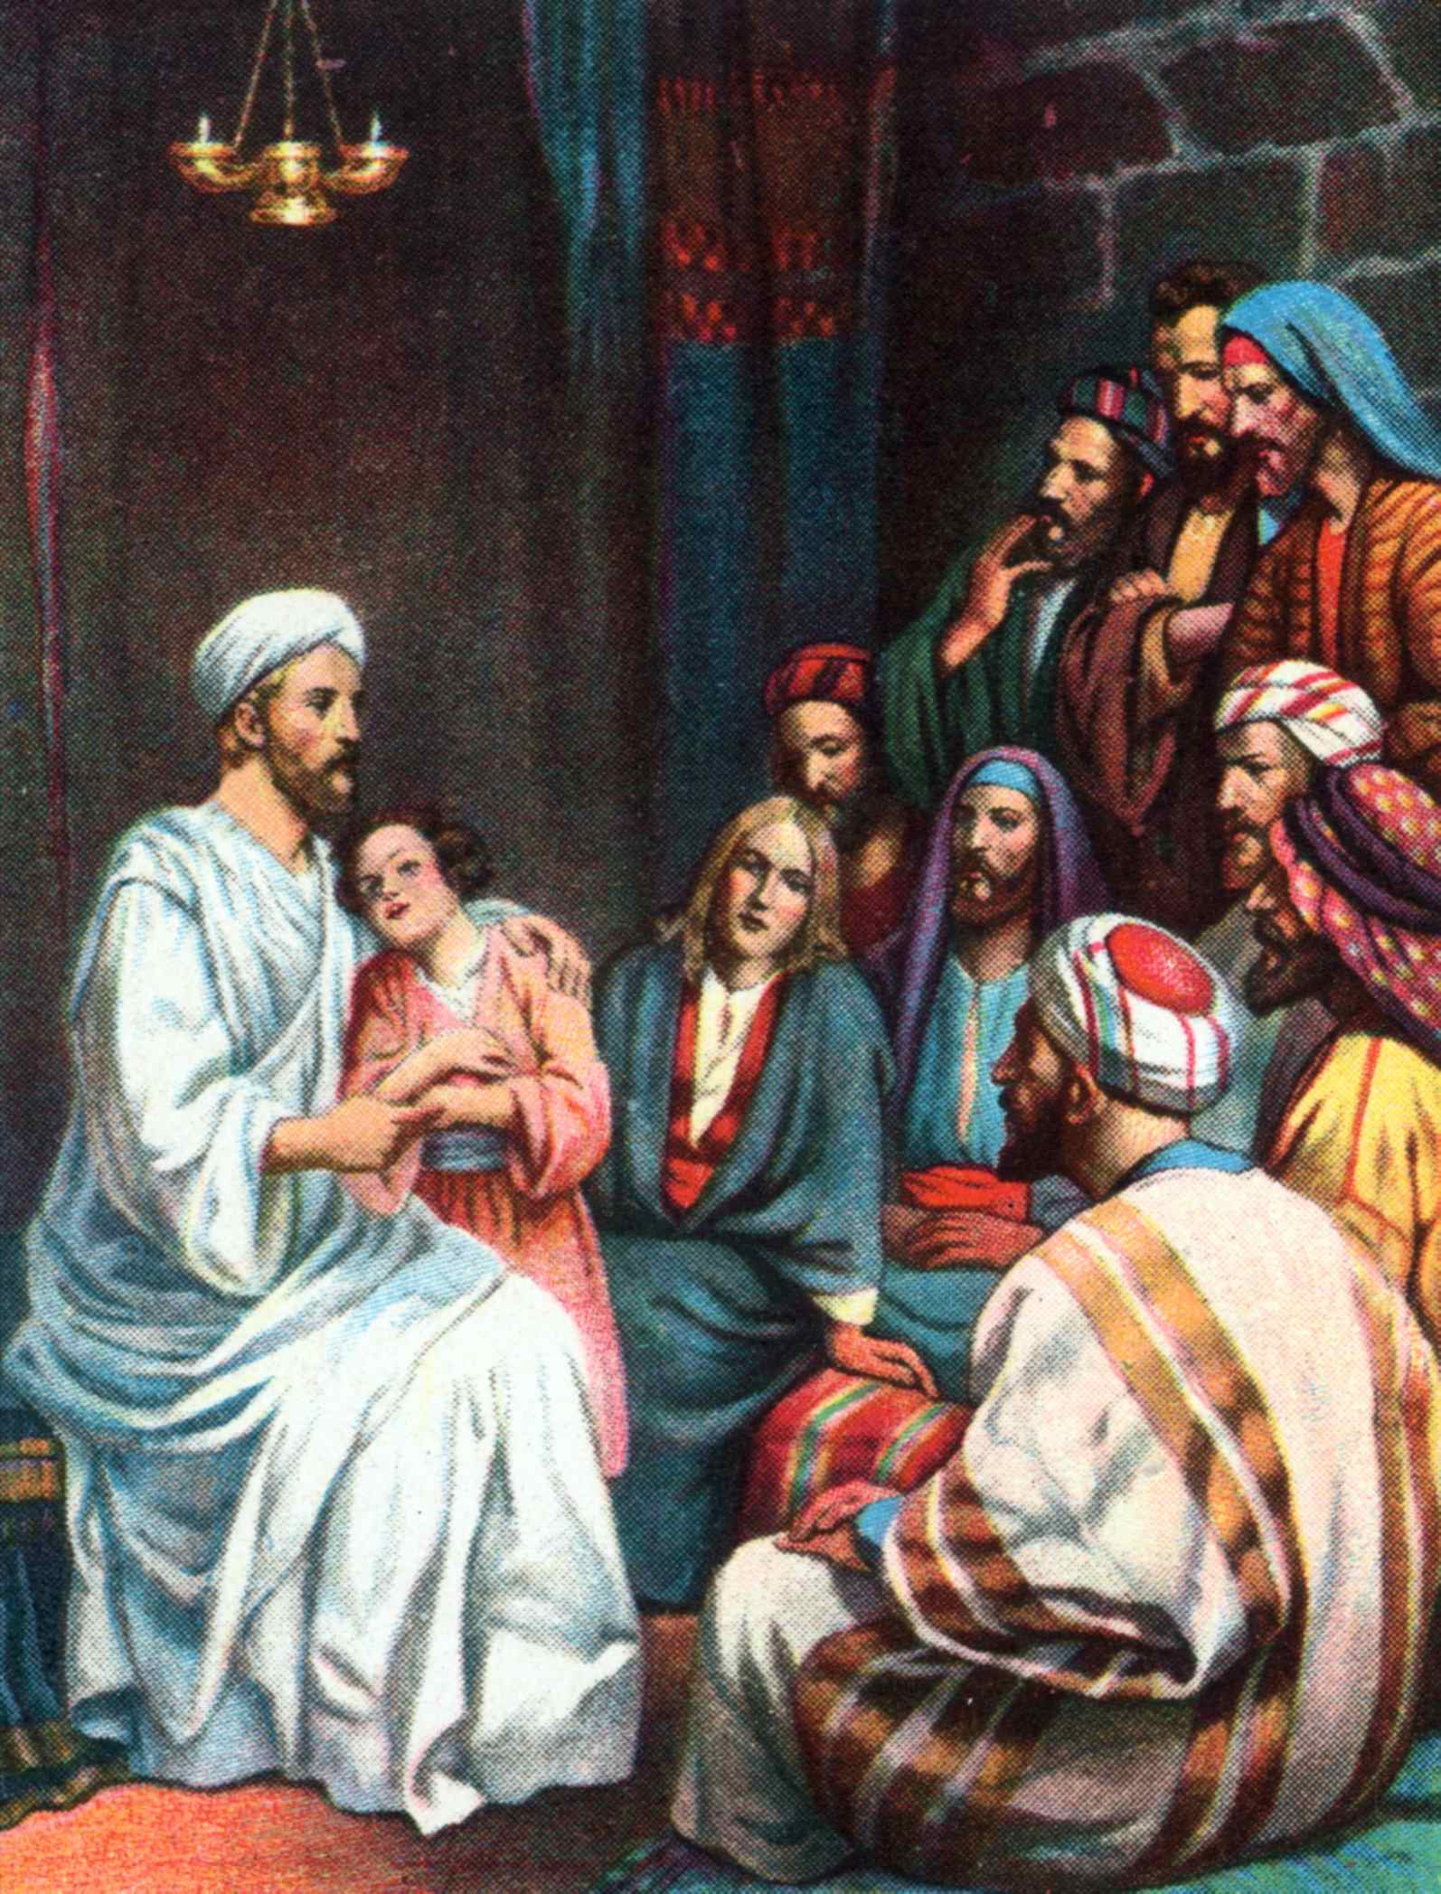

Slide 9
Matthew 18:3 "Assuredly, I say to you, unless you are converted and become as little children, you will by no means enter the kingdom of heaven. ⁴ "Therefore whoever humbles himself as this little child is the greatest in the kingdom of heaven.

Slide 10
Philippians 2:3 Let nothing be done through selfish ambition or conceit, but in lowliness of mind let each esteem others better than himself. ⁴ Let each of you look out not only for his own interests, but also for the interests of others. ⁵ Let this mind be in you which was also in Christ Jesus, ⁶ who, being in the form of God, did not consider it robbery to be equal with God, ⁷ but made Himself of no reputation, taking the form of a bondservant, and coming in the likeness of men.

Slide 11
⁸ And being found in appearance as a man, He humbled Himself and became obedient to the point of death, even the death of the cross. ⁹ Therefore God also has highly exalted Him and given Him the name which is above every name, ¹⁰ that at the name of Jesus every knee should bow, of those in heaven, and of those on earth, and of those under the earth, ¹¹ and that every tongue should confess that Jesus Christ is Lord, to the glory of God the Father.

Slide 12
Matthew 18:5 "Whoever receives one little child like this in My name receives Me.

Slide 13
Mark 9:37 "Whoever receives one of these little children in My name receives Me; and whoever receives Me, receives not Me but Him who sent Me."

Slide 14
John 14:6 Jesus said to him, "I am the way, the truth, and the life. No one comes to the Father except through Me.

Slide 15
2 John 1:9 Whoever transgresses and does not abide in the doctrine of Christ does not have God. He who abides in the doctrine of Christ has both the Father and the Son.

Slide 16
Mark 9:38 Now John answered Him, saying, "Teacher, we saw someone who does not follow us casting out demons in Your name, and we forbade him because he does not follow us." ³⁹ But Jesus said, "Do not forbid him, for no one who works a miracle in My name can soon afterward speak evil of Me. ⁴⁰ "For he who is not against us is on our side. ⁴¹ "For whoever gives you a cup of water to drink in My name, because you belong to Christ, assuredly, I say to you, he will by no means lose his reward.

Slide 17
Acts 19:15 And the evil spirit answered and said, "Jesus I know, and Paul I know; but who are you?" ¹⁶ Then the man in whom the evil spirit was leaped on them, overpowered them, and prevailed against them, so that they fled out of that house naked and wounded.

Slide 18
³⁹ But Jesus said, "Do not forbid him, for no one who works a miracle in My name can soon afterward speak evil of Me. ⁴⁰ "For he who is not against us is on our side. ⁴¹ "For whoever gives you a cup of water to drink in My name, because you belong to Christ, assuredly, I say to you, he will by no means lose his reward.

Slide 19
Mark 9:42 " But whoever causes one of these little ones who believe in Me to stumble, it would be better for him if a millstone were hung around his neck, and he were thrown into the sea.

Slide 20
James 3:1 My brethren, let not many of you become teachers, knowing that we shall receive a stricter judgment.

Slide 21
Mark 9:43 "If your hand causes you to sin, cut it off. It is better for you to enter into life maimed, rather than having two hands, to go to hell, into the fire that shall never be quenched -- ⁴⁴ "where 'Their worm does not die, And the fire is not quenched.' ⁴⁵ "And if your foot causes you to sin, cut it off. It is better for you to enter life lame, rather than having two feet, to be cast into hell, into the fire that shall never be quenched -- ⁴⁶ "where 'Their worm does not die, And the fire is not quenched.' ⁴⁷ "And if your eye causes you to sin, pluck it out. It is better for you to enter the kingdom of God with one eye, rather than having two eyes, to be cast into hell fire -- ⁴⁸ "where 'Their worm does not die, And the fire is not quenched.'

Slide 22
Revelation 14:10 He shall be tormented with fire and brimstone in the presence of the holy angels and in the presence of the Lamb. ¹¹ "And the smoke of their torment ascends forever and ever; and they have no rest day or night, who worship the beast and his image, and whoever receives the mark of his name."

Slide 23
Revelation 20:10 The devil, who deceived them, was cast into the lake of fire and brimstone where the beast and the false prophet are. And they will be tormented day and night forever and ever.

Slide 24
⁴⁹ " For everyone will be seasoned with fire, and every sacrifice will be seasoned with salt.

Slide 25
⁵⁰ "Salt is good, but if the salt loses its flavor, how will you season it? Have salt in yourselves, and have peace with one another."

Slide 26
Matthew 18:10 " Take heed that you do not despise one of these little ones, for I say to you that in heaven their angels always see the face of My Father who is in heaven. ¹¹ "For the Son of Man has come to save that which was lost.

Slide 27
It is true that angels are said to minister to the saved (Heb. 1:14), and one of their roles is guarding and protecting (Ps. 34:7; 91:11-12). The people who were praying for Peter made a statement that implies they thought that Peter had an angel (Acts 12:14-15).

Slide 28
Deuteronomy 29:29 "The secret things belong to the LORD our God, but those things which are revealed belong to us and to our children forever, that we may do all the words of this law.

Slide 29
Matthew 18:12 "What do you think? If a man has a hundred sheep, and one of them goes astray, does he not leave the ninety-nine and go to the mountains to seek the one that is straying? ¹³ "And if he should find it, assuredly, I say to you, he rejoices more over that sheep than over the ninety-nine that did not go astray. ¹⁴ "Even so it is not the will of your Father who is in heaven that one of these little ones should perish.

Slide 30
